Slide 1
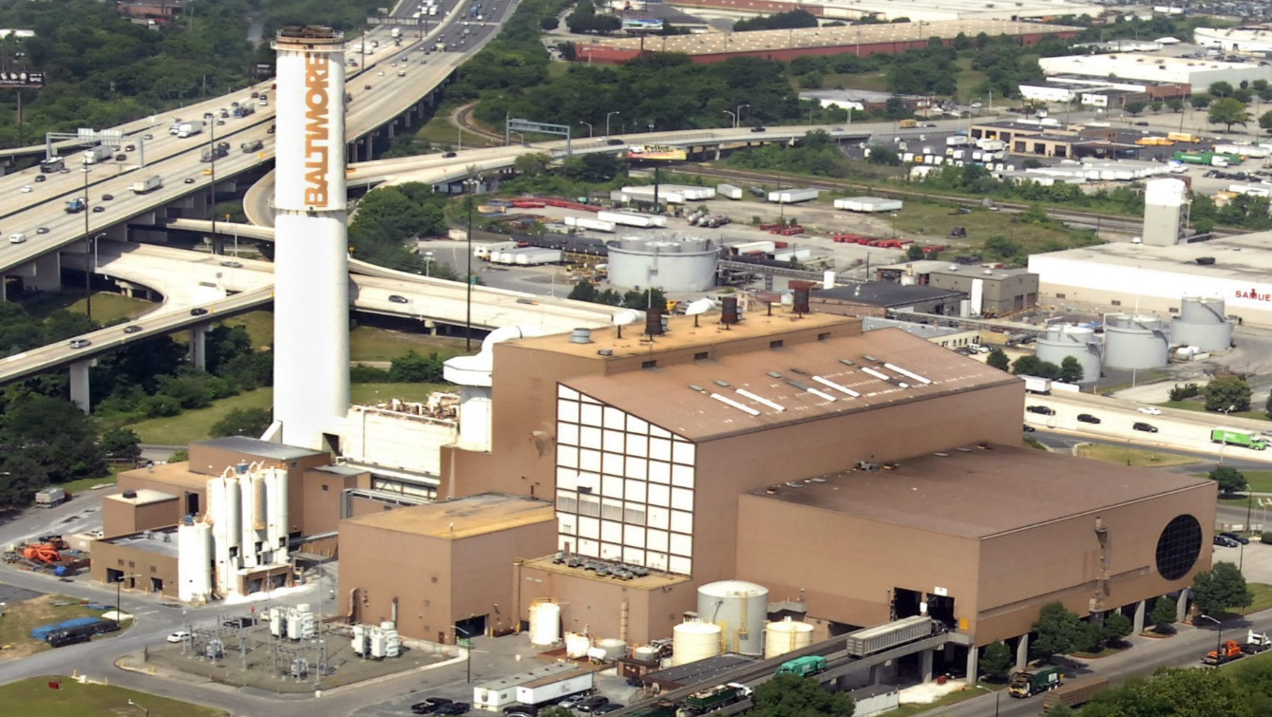
Energy Justice Network
Incinerator and Zero Waste Presentation Baltimore City Sustainability Commission November 29, 2016

Slide 2
Notes:
Ask: What are some problems with landfills?
Answers: Landfills often are massive, stink (straight-up stank), and always will leak at some point
- This lead to a much greater interest in incineration

Slide 3
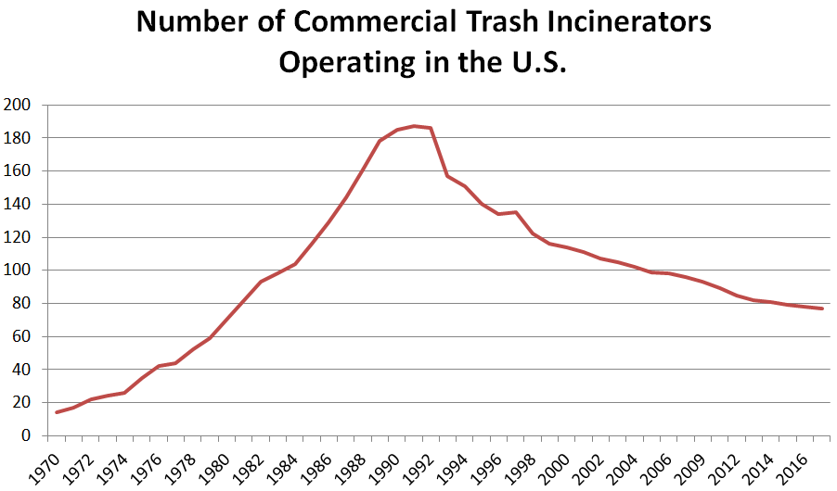
Notes:
http://www.energyjustice.net/incineration
Incineration is the most expensive and polluting way to make energy or to manage waste (mention put-or-pay, bankruptcy in Harrisburg, near-bankruptcy in Detroit)
They are inherently more complicated to operate and the cost gap increases over time as the enormous expense of pollution controls keeps incinerators expensive as air regulations gradually tighten.
2016 - Lowest number of incinerators (77) in operation since 1981
Hadn’t been a new one built for decades until the West Palm Beach facility – 3,000 tons per day, in addition to the existing 2,000-ton facility a few years ago

Slide 4
Baltimore Community Statistical Areas (CSAs)
Source: Baltimore City Health Department
Notes:
The statistics on the Curtis Bay region are astonishing – to this day, toxic air pollutants from Baybrook account for 37 percent of the entire amount of toxic emissions from the State of Maryland, and 87 percent of all toxic emissions from Baltimore City (EIP, 2012). From 2005 (7th) to 2009 (2nd), Curtis Bay ranked among the top ten zip codes in the United States when discussing toxic emissions from stationary sites. “In 2007 and 2008, Curtis Bay ranked first in the entire country for quantity of these releases, with 20.6 and 21.6 million pounds released respectively each year” (EIP, 2012).
These include oil and petroleum processors like Citgo Petroleum Group, the Baltimore Regional Medical Waste Incinerator, a wastewater treatment plant, and the Wagner and Brandon Shores Generating Stations, and the Erachim Comilog chemical company, among others (EIP, 2014).

Slide 5
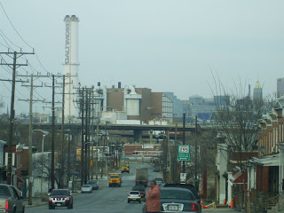
Demographics
65.2% African American 17.2% White 13.1% Latino
Socioeconomics
16.2% Unemployment 28% Poverty Rate 72.5% With HS Diploma or Less Vacant Lot Density: 927 per 10K – 42nd
Mortality
Life Expectancy: 73.3 – 24th Avertable Deaths: 50.9% -- 40th Deaths by Chronic Respiratory Disease: 6.5 per 10,000 – 46th
Sources: BNIA; BCHD Neighborhood Profile
Notes:
(per 10,000 Residents) - YPLL
Data from 2014 BNIA and 2011 Community Profile
24th of 55 in Life Expectancy
Unemployment Rate is higher than BC rate of 14.1 Poverty Rate is higher than BC rate of 19.1
Life Expectancy Brooklyn/Curtis Bay/Hawkins Point: 69.5 (45th) Change Cherry Hill 69.3 (46th) Change
Age-Adjusted Mortality (Deaths per 10,000): 125.7 (110.4)
Years of potential life lost (YPLL) is a measure of the impact of premature mortality on a population. Premature mortality is death before the age of 75.
Avertable deaths are deaths that could have been avoided if all Baltimore communities had the same opportunity at health. Data presented here are based on the assumption that the death rates achieved in the five communities with the highest incomes (>$75,000) should be achievable in every community, regardless of income.
Only 6.1 percent with a Bachelor’s Degree or more
South Baltimore: 5th worst in Chronic Respiratory Disease deaths Inner Harbor/Federal Hill: 7th worst in Chronic Respiratory Disease deaths

Slide 6
General Information
Name: Wheelabrator Baltimore (formerly BRESC0)
Opened: 1985
Capacity: 2,250 tons of municipal solid waste (MSW) daily
Power Production: 60MW (At Capacity)
Contract:
Signed: June 22, 2011 Enacted: July 1, 2011 Terminated: December, 31, 2021
Sources: Wheelabrator/Baltimore City Contract, Wheelabrator Website
Notes:
Incinerators rarely, if ever, run at full capacity, and many days, boilers have to shut down due to malfunctioning Baltimore’s contract purchased 10MW Receiving hours are 24/7, excluding holidays, burn 24/7 Baltimore is obligated to deliver ALL MSW to Wheelabrator Only if it goes through the recycling stream does it not have to be sent
***Ask if Host Community Fee is “general” or specific to Westport, and if it actually goes there
52ishMW at 87%

Slide 7
Your Ash Has a Problem…
Bottom ash and fly ash are produced by incinerators
Abatement equipment in modern incinerators transfer the toxic load into the fly ash
Trucked to landfill, and sometimes used as an alternative daily cover material
A poorly understood health hazard
Source: British Society of Ecological Medicine
Notes:
Bottom: The non-combustible residue caught on the grate in the boiler
Fly Ash: What’s caught by the pollution controls, only 10 percent of the ash
2010 – MDE restricted Baltimore City from using it as an ADCM at Quarantine Road, deeming it’s not as safe as soil, but Wheelabrator wants the City to propose using it for that purpose again
In May 1994, the U.S. Supreme Court made a ruling that incinerator ash that tests hazardous for toxic heavy metals such as lead and cadmium must be disposed of in hazardous waste landfills rather than in solid waste dumps.
It is considered hazardous waste under international law, but EPA allowed ways to get around this designation, including changing the standard test, not testing for what’s in the ash, but just what leaches out under pH-manipulated conditions, and allowing the mixing of the bottom and fly ash so the combined amount seems less toxic
Toxic metals like lead and cadmium are within the ash, accumulate in the body, and have been implicated in a range of emotional and behavioural problems in children including autism, dyslexia, attention deficit and hyperactivity disorder (ADHD), learning difficulties, and delinquency, and in problems in adults including violence, dementia, depression and Parkinson’s disease.
It's been used for "coral reefs" in the Bahamas and off of Long Island, for parking lots and road base in TN, ME and PA, but those latter efforts failed and were stopped.
In 2012/2013, site visits found that the city still was using it as ADCM

Slide 8
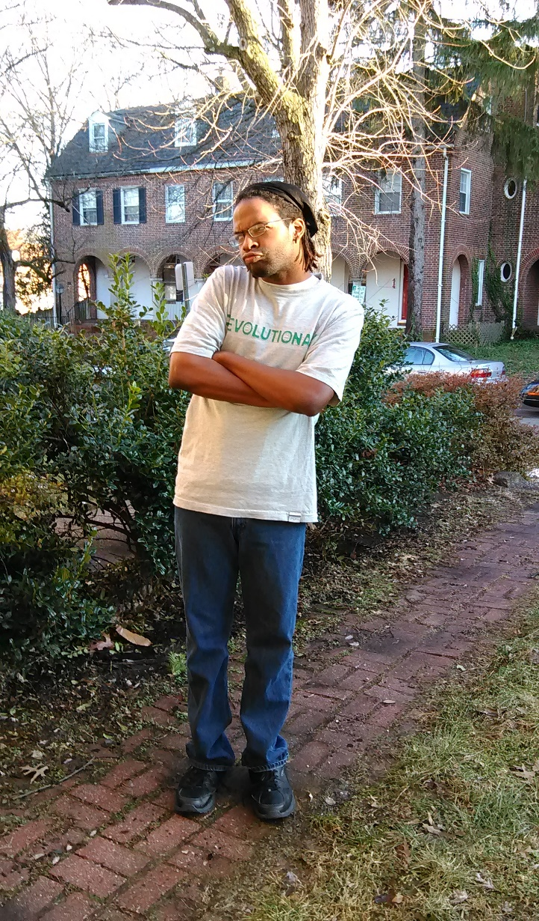
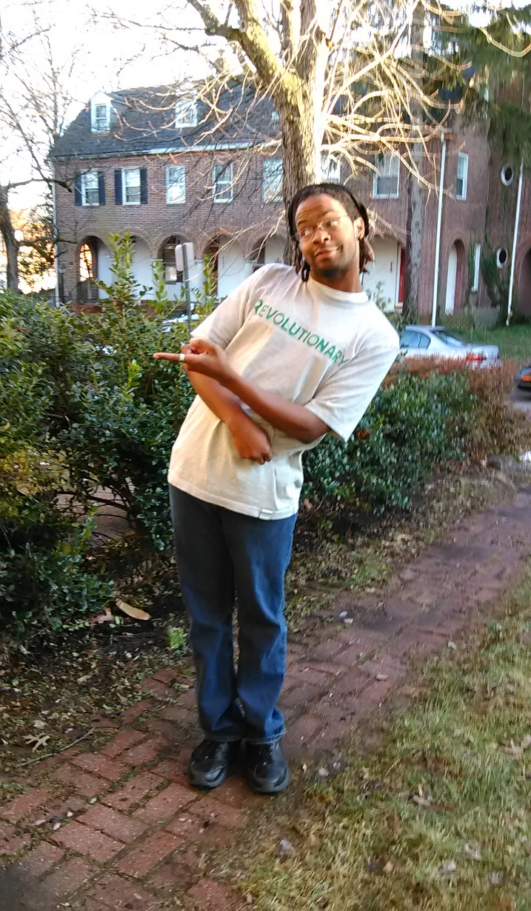
And remember…
Incineration is NOT “waste-to-energy”…
Incineration is a waste OF energy!
Notes:
There is no such thing as waste-to-energy. "Waste-to-energy" is a public relations term used by incinerator promoters, but is not an accurate term, scientifically, as there is no such thing. In the bigger picture, they're waste-OF-energy facilities. (Only nuclear reactions convert matter to energy.)
In the environmental advocacy community, we've come to call them "waste-OF-energy" facilities because we know that recycling and composting the same discarded materials saves 3-5 times as much energy as incinerators can recover.
It's self-evident, as all of the energy it takes to make paper, for instance (cutting trees, trucking them to a paper mill, burning coal to power the mill, shipping the paper around more...) isn't all present in the paper itself, as much of it went up the smokestacks at the mill or the tailpipes of the logging and trucking equipment. Recycling the same paper saves that energy by avoiding new extraction and production.
Other Names Used
Energy from Waste (EfW)
Trash-to-steam
Conversion technologies
Biomass
Advanced Thermal Tech
Waste to Fuel (WTF?)

Slide 9
Total Emissions, 2011 (in Tons)
Source: EPA National Emissions Inventory
Notes:
1630.55 tons, or 3,261,091.27lbs. – more than twice that of Grace-Davison

Slide 10
Nitrogen Oxide Emissions, 2011 (in Tons)
Source: EPA National Emissions Inventory

Slide 11
Sulfur Dioxide Emissions, 2011
Source: EPA National Emissions Inventory
Notes:
261.297 tons

Slide 12
PM2.5 Emissions (in Tons), 2011
Source: EPA National Emissions Inventory

Slide 13
SOLUTIONS: The Move to Zero Waste

Slide 14
Three Main Options for Waste Disposal
Direct landfilling
Incinerate first, then landfilling
Zero waste approach
Notes:
30 tons of ash for every 100 tons of waste – 70 percent reduction, but still dealing with ash (90% volume reduction)
ZWA: Still can get 90% volume reduction, but without as much pollution and no ash to handle,

Slide 15
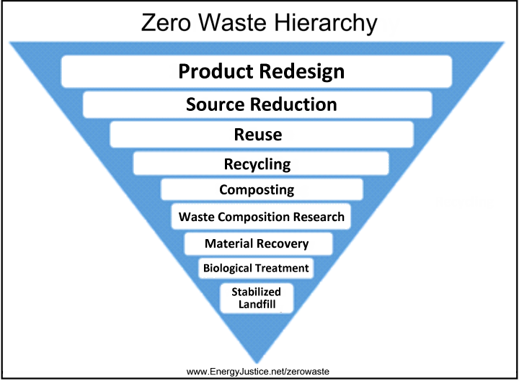

Slide 16
Proposed Solutions
Pass a Clean Air Ordinance
Provide 25-gallon recycling bins to all Baltimore residents for free (Divert Baltimore)
Provide same and/or larger bins to businesses at a discounted rate
Implement Charm City Save Money and Reduce Trash (SMART)
Open a Material Recovery Facility (MRF)/Mechanical Recovery, Biological Treatment (MRBT), composting, and/or anaerobic digestion facilities in Westport
Do not renew the Wheelabrator contract!
Notes:
Research conducted by the Institute for Local Self-Reliance (Pay Dirt, 2013) found that composting yields 4.1 jobs per 10,000 tons of material Landfilling – 2.1 Incineration 1.2
The City mentions in its Ten-Year Solid Waste Plan interest in having its own composting center; concerned about capital costs and finding partners
Material Recovery, Biological Treatment is a process to pre-treat leftover waste before landfilling in order to recover additional materials for recycling and minimize the impacts from landfilling.

Slide 17
Clean Air Ordinance
Requires facilities burning a minimum of 25 tons of waste daily to install up-to-date pollution controls and post emissions data online in real-time
Would include Wheelabrator and Curtis Bay Energy
Facilities would be tasked to monitor 20 emissions continuously
Penalized for each violation of each pollutant daily
Notes:
CBE – The largest medical waste incinerator in the US; burns up to 70 tons daily, Over 400 violations in the last two years before it was bought in 2005
No new pollution controls at Wheelabrator since 2000/01
CO, NOx, and SO2 are the only local pollutants continuously monitored at Wheelabrator
Md. ENVIRONMENT Code Ann. § 2-104
ENVIRONMENT TITLE 2. AMBIENT AIR QUALITY CONTROL SUBTITLE 1. DEFINITIONS; GENERAL PROVISIONS
§ 2-104. Powers of political subdivisions (a) Adopting ordinances, rules, or regulations. -- (1) Except as provided in this section, this title does not limit the power of a political subdivision to adopt ordinances, rules, or regulations that set emission standards or ambient air quality standards. (2) A political subdivision may not adopt any ordinance, rule, or regulation that sets an emission standard or ambient air quality standard less stringent than the standards set by the Department under this title. (b) Requesting rules or regulations. -- The governing body of any political subdivision may ask the Department to adopt rules and regulations that set more restrictive emission standards or ambient air quality standards in that political subdivision. HISTORY: An. Code 1957, art. 43, §§ 693, 705; 1982, ch. 240, § 2.

Slide 18
Divert Baltimore

Slide 19
The Basics
A Community Statistical Area(s) (CSAs) is distributed the 25-gallon recycling bins for free
Education campaign on health and financial costs of incineration
Each CSA(s) is tasked to recycle an additional 24.7 percent of annual solid waste production, or 1.29lbs per household daily
This amount breaks the City even on the revenue lost from free distribution by diverting tipping fee costs
If the CSA(s) surpasses the breakeven point, it is rewarded through a Community Betterment Fund (CBF), where various projects can be funded or assisted by the diverted tipping fee costs Breakdown 70% - CBF 15% - Solid Waste Enterprise Fund 15% - General Fund
Notes:
Funds come from the Wheelabrator account
The CBF shall be committed to various projects advocated by members of the given community and their respective legislator, such as community gardens to help diminish Baltimore City’s food desert epidemic; the purchase and planting of trees to improve air quality and the aesthetic of a community; or ground-facing streetlights to diminish light pollution and minimize potential crime locations
Collaboration on the EC with organizations like United Workers, Blue Water Baltimore, and Clean Water Action

