Slide 1
Becoming a ‘Green’ Youthworks Site
Expanding Environmental Career Exposure

Slide 2
Agenda
Introduction
Overview: Cities Connecting Children to Nature (CCCN)
Current state of YouthWorks
GBCAN +
Steps to become a Youthworks Site
Active Programs and Insight
Best practices working with youth
Key lessons
Q&A

Slide 3
Cities Connecting Children to Nature:
Increasing Equitable Access to Nature in Baltimore

Slide 4
Baltimore City Strategy: Green Career Exposure
Support and develop youth employment programs that create a cleaner and greener Baltimore and a green career exploration that highlights the importance of a relationship with nature.

Slide 5
YouthWorks and Green Careers
YouthWorks sites in the environmental/green sector:
41 worksites included environmental work
35 sites worked on planting, gardening, or other outdoor environmental jobs
6 sites focused on environmental education
705 youth placed at “green” sites
2019 YouthWorks stats:
8600+ jobs offered
600+ different worksites

Slide 6
The Vision:
The Greater Baltimore Children And Nature Collaborative encourages partnerships and provides information to foster caring connections with nature. Recognizing that nature connections are important for everyone (children and adults), members of this collaborative believe the health and well being of children and the natural world need special guidance and attention.
Guiding principles to promote nature connections :
Nature as Teacher and Nurturer
Connection
Community and Society
Role Models
Respect
Access

Slide 7
Logistics
2020 Timeline:
January 2 - March 31: Worksite applications are accepted
January 2 - March 1: Baltimore City youth ages 14-21 can submit an online application
January 28 - March 28: YouthWorks schedules Face to Face verification interview with youth
Timeline, Procedures, and Deal-Breakers

Slide 8
Sam Little - Parks and People
Why YouthWorks?
Past participation in YouthWorks
Youth impact stats
Key youth tasks and responsibilities
Best practices
Video link

Slide 9
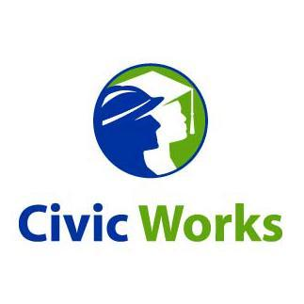
Gwen Kokes - Civic Works
Why YouthWorks?
Past participation in YouthWorks
Youth impact stats
Key youth tasks and responsibilities
Best practices

Slide 10
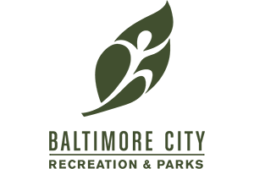
Mary Hardcastle - Carrie Murray Nature Center
Why YouthWorks?
Past participation in YouthWorks
Youth impact stats
Key youth tasks and responsibilities
Best practices

Slide 11
Nicole McDaniels - Baltimore City Recreation & Parks
Why YouthWorks?
Past participation in YouthWorks
Youth impact stats
Key youth tasks and responsibilities
Best practices

Slide 12
‘Must Haves’
Best Practices:
-organizational preparedness
-requesting Youth who you already have a relationship with
-clear structure and management
-have a plan, but be flexible

Slide 13
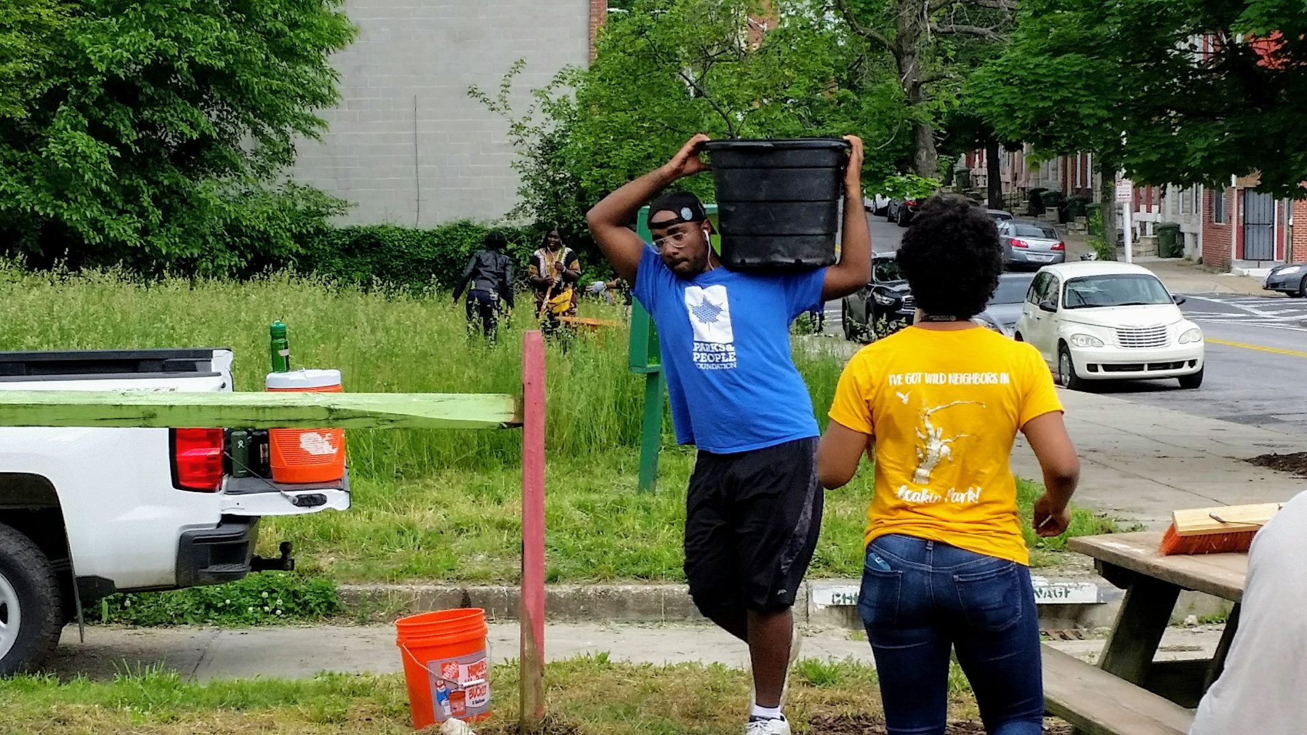
Overarching Lessons Learned

Slide 14
Questions?

Slide 15
Contact Information
Useful Links
Anika Richter: anika.richter@baltimorecity.gov
Mary Hardcastle: mary.hardcastle@baltimorecity.gov
Eric Somerville: ericsomerville@ymaryland.org
Jannie Williams: jwilliams@oedworks.com
Nicole McDaniels: nicole.mcdaniels@baltimorecity.org
Sam Little: sam.little@parksandpeople.org
Gwen Kokes: gkokes@civicworks.com
Register for Upcoming YouthWorks Site Info Sessions [12/9, 12/11, 12/16]
Website for becoming a Host Site

